Slide 1

Spring Introduction MVC
Spring Fundamentals
SoftUni Team
Technical Trainers
Software University
https://softuni.bg

Slide 2
Table of Content
What is Spring MVC
Inversion of Control
Spring MVC Controllers
Layers – dividing code
Thin Controllers

Slide 3
Questions
sli.do #java-web

Slide 4

What is Spring MVC?

Slide 5
What is Spring MVC?
Model-view-controller (MVC) framework is designed around a DispatcherServlet that dispatches requests to handlers
Find Controller
Handler
Mapping
Controller
Service
Request
Execute
Action
Dispatcher Servlet
Handler
Adapter
View Name
Repository
View
Resolver
Result Model
Resolve View
DB
Response
View
Result Model
Model
Business Logic
Notes:
Blue Color – Provided by Spring Purple Color – To Be Implemented by the Developer Green Color – Provided by Spring. Sometimes implemented by the developer

Slide 6
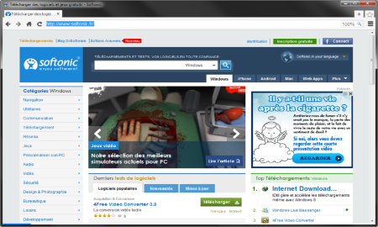



MVC – Control Flow
Web Client
Request
Controller
Response (html, json, xml)
Create Model
User Action
Update View
Model
View

Slide 7
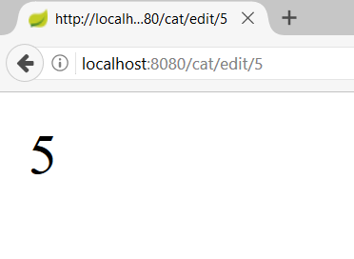
Path Variables
CatController.java
@Controller
@RequestMapping("/cat")
public class CatController {
@GetMapping("/edit/{catId}")
@ResponseBody
public String editCat(@PathVariable long catId){
return String.valueOf(catId);
}
}
Path Variable

Slide 8

Spring Controllers
Annotations, IoC Container

Slide 9
Spring Controllers
Defined with the @Controller annotation
Controllers can contain multiple actions on different routes
@Controller
public class HomeController {
...
}

Slide 10
Request Mapping
Annotated with with @RequestMapping(…)
Or
@RequestMapping("/home")
public String home() {
return "home-view";
}
@RequestMapping("/home")
public ModelAndView home(ModelAndView mav) {
mav.setViewName("home-view");
return mav;
}

Slide 11
Request Mapping
Problem when using @RequestMapping is that it accepts all types of request methods (get, post, put, delete, head, patch)
Execute only on GET requests
@RequestMapping(value="/home", method=RequestMethod.GET)
public String home() {
return "home-view";
}

Slide 12
Get Mapping
Easier way to create route for a GET request
This is alias for RequestMapping with method GET
@GetMapping("/home")
public String home() {
return "home-view";
}

Slide 13
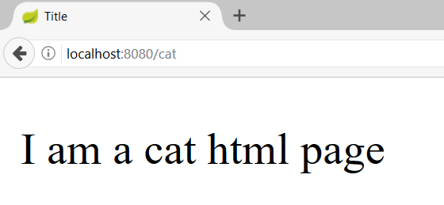
Actions – Get Requests
CatController.java
@Controller
public class CatController {
@GetMapping("/cat")
public String getHomeCatPage(){
return "cat-page.html";
}
}
Request Mapping
Action
View

Slide 14
Controllers
Controller
DogController.java
@Controller
public class DogController {
@GetMapping("/dog")
@ResponseBody
public Game getDogHomePage(){
Game game = gameService.getBestGame();
return game;
}
}
Request Mapping
Action

Slide 15
Post Mapping
Similar to the GetMapping there is also an alias for RequestMapping with method POST
Similar annotations exist for all other types of request methods
@PostMapping("/register")
public String register() {
…
}

Slide 16
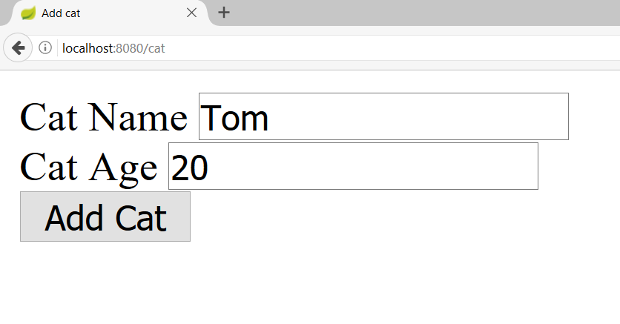
Actions – Post Requests (1)
CatController.java
@Controller
@RequestMapping("/cat")
public class CatController {
@GetMapping("")
public String addCat(){
return "new-cat.html";
}
}
Starting route

Slide 17

Actions – Post Requests (2)
CatController.java
@Controller
@RequestMapping("/cat")
public class CatController {
@PostMapping("")
public String addCatConfirm(@RequestParam String catName, @RequestParam int catAge){
System.out.println(String.format( "Cat Name: %s, Cat Age: %d", catName, catAge));
return "redirect:/cat";
}
}
Request param
Redirect

Slide 18
Passing Attributes to View
Passing a String to the view
The Model object will be automatically passed to the view as context variables
Attributes can be accessed from Thymeleaf
@GetMapping("/")
public String welcome(Model model) {
model.addAttribute("name", "Pesho");
return "index";
}

Slide 19
Passing Attributes to View (2)
Passing a ModelMap object to the view
The ModelMap object will be automatically passed to the view as context variables
Attributes can be accessed from Thymeleaf
@GetMapping("/")
public String welcome(ModelMap modelMap) {
modelMap.addAttribute("name", "Pesho");
return "index";
}

Slide 20
Passing Attributes to View (3)
Passing a ModelAndView object to the view
The ModelAndView object will be automatically passed to the view as context variables
Attributes can be accessed from Thymeleaf
@GetMapping("/")
public ModelAndView welcome(ModelAndView model) {
model.addObject("name", "Pesho");
model.setViewName("index")
return model;
}

Slide 21
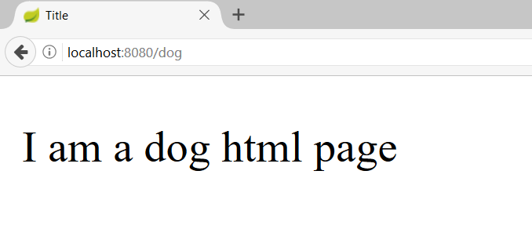
Models and Views
DogController.java
@Controller
public class DogController {
@GetMapping("/dog")
public ModelAndView getDogHomePage(ModelAndView modelAndView){
modelAndView.setViewName("dog-page.html");
return modelAndView;
}
}
Model and View

Slide 22
Request Parameters
Getting a parameter from the query string
@RequestParam can also be used to get POST parameters
@GetMapping("/details")
public String details(@RequestParam("id") Long id) {
...
}
@PostMapping("/register")
public String register(@RequestParam("name") String name) {
...
}

Slide 23
Request Parameters with Default Value
Getting a parameter from the query string
Making parameter optional
@GetMapping("/comment")
public String comment(@RequestParam(name="author", defaultValue = "Annonymous") String author) {
...
}
@GetMapping("/search")
public String search(@RequestParam(name="sort",
required = false) String sort) {
...
}

Slide 24
Path Variable
Getting a parameter from the query string
@GetMapping("/details/{id}")
public String details(@PathVariable("id") Long id) {
...
}

Slide 25
Form Objects
Spring will automatically try to fill objects with a form data
The input field names must be the same as the object field names
@PostMapping("/register")
public String register(@ModelAttribute UserDTO userDto) {
...
}

Slide 26
Redirecting
Redirecting after POST request
@PostMapping("/register")
public String register(@ModelAttribute UserDTO userDto) {
...
return "redirect:/login";
}

Slide 27
Redirecting with Parameters
Redirecting with query string parameters
@PostMapping("/register")
public String register(@ModelAttribute UserDTO userDto,
RedirectAttributes redirectAttributes) {
redirectAttributes.addAttribute("errorId", 3);
return "redirect:/login";
}

Slide 28
Redirecting with Attributes
Keeping objects after redirect
@PostMapping("/register")
public String register(@ModelAttribute UserDTO userDto,
RedirectAttributes redirectAttributes) {
...
redirectAttributes.addFlashAttribute("userDto", userDto);
return "redirect:/register";
}

Slide 29

Inversion of Control
Constructor vs Field vs Setter Injection

Slide 30

Field Injection
Easy to write
Easy to add new dependencies
It hides potential architectural problems!
@Autowired
private ServiceA serviceA
@Autowired
private ServiceB serviceB
@Autowired
private ServiceC serviceC

Slide 31

Constructor Injection
Time Consuming
Harder to add dependencies
It shows potential architectural problems!
@Autowired
public ControllerA(ServiceA serviceA, ServiceB serviceB, ServiceC serviceC) {
this.serviceA = serviceA;
this.serviceB = serviceB;
this.serviceC = serviceC;
}

Slide 32
Setter Injection
Create setters for dependencies
Can be combined easily with constructor injection
Flexibility in dependency resolution or object reconfiguration!
@Service
public class HomeContoller(){
//...
@Autowired
public void setServiceA(ServiceA serviceA) {
this.serviceA = serviceA;
}
}

Slide 33
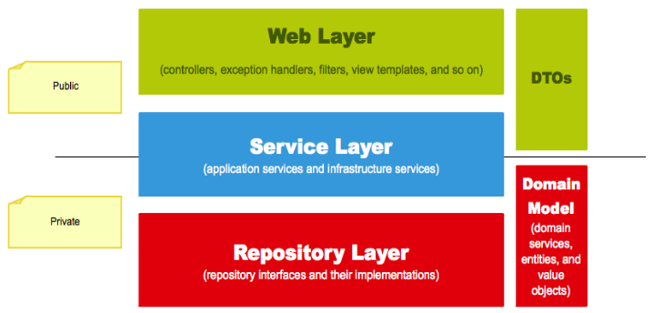
Layers
The Correct Project Structure

Slide 34
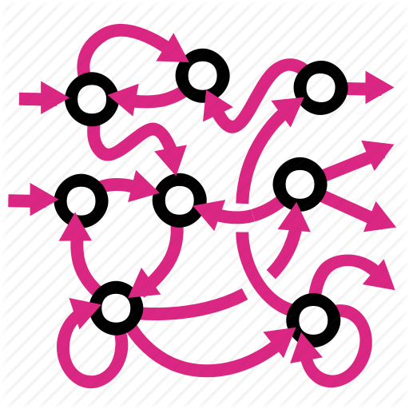
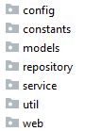

Layers
We are used to splitting our code based on its functionality:
It gets hard to navigate in bigger applications

Slide 35


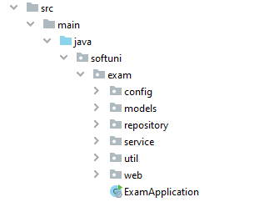
Layers (2)
Splitting the project into different modules
Each module corresponding to the application layer
Makes it easier to navigate

Slide 36

Thin Controllers
Creating Simple Components

Slide 37
Thin Controllers
Controllers should follow well known principles such as DRY and KISS
Should delegate functionality to the service layer
The service layer consists of application logic, e.g. services, executors, strategies, mappers, DTOs, entities, etc.

Slide 38

Live Demo

Slide 39

Summary
Spring MVC - MVC framework that has three main components:
Controller - controls the application flow
View - presentation layer
Model - data component with the main logic
Constructor injection – the best way for DI
Splitting your application code by layers
Every component should be as "thin" as possible
…
…
…

Slide 40
Questions?
Notes:
40

Slide 41










SoftUni Diamond Partners

Slide 42



Educational Partners

Slide 43
Trainings @ Software University (SoftUni)
Software University – High-Quality Education, Profession and Job for Software Developers
softuni.bg, about.softuni.bg
Software University Foundation
softuni.foundation
Software University @ Facebook
facebook.com/SoftwareUniversity
Software University Forums
forum.softuni.bg
Notes:
43

Slide 44

License
This course (slides, examples, demos, exercises, homework, documents, videos and other assets) is copyrighted content
Unauthorized copy, reproduction or use is illegal
© SoftUni – https://about.softuni.bg/
© Software University – https://softuni.bg
Notes:
44

